Slide 1
AASD4011: Mathematical Concepts for Deep Learning
Resources

Slide 2
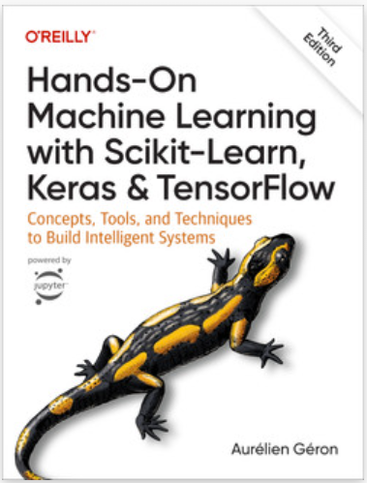
Book: Hands-On Machine Learning with Scikit-Learn, Keras, and TensorFlow, Aurélien Géron (October 2022)
O’Reily (publisher)
Github repo of the book - contains the code, but not the text.

Slide 3
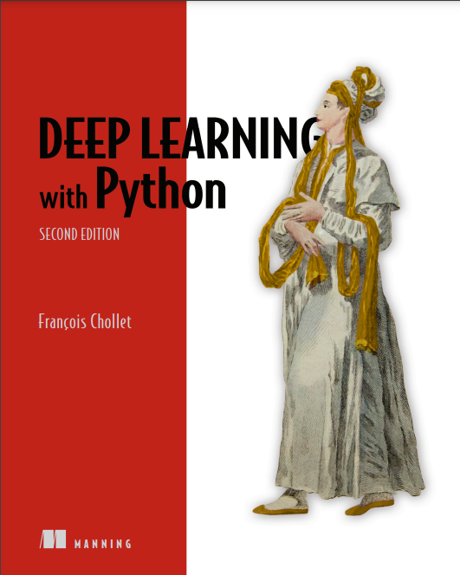
Book: Deep Learning with Python, François Chollet (2nd Edition, October 2021)
Manning (publisher) - ebook (pdf, epub - drm free; kindle)
Github repo - notebooks with code only

Slide 4
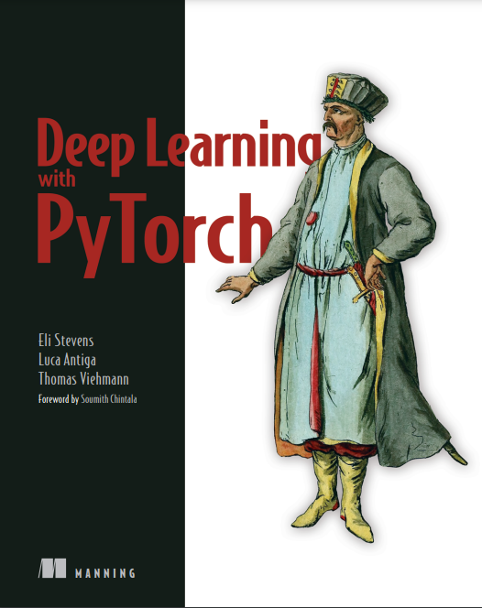
Book: Deep Learning with PyTorch, Eli Stevens, Luca Antiga, and Thomas Viehmann, July 2020, Manning, Github repo

Slide 5
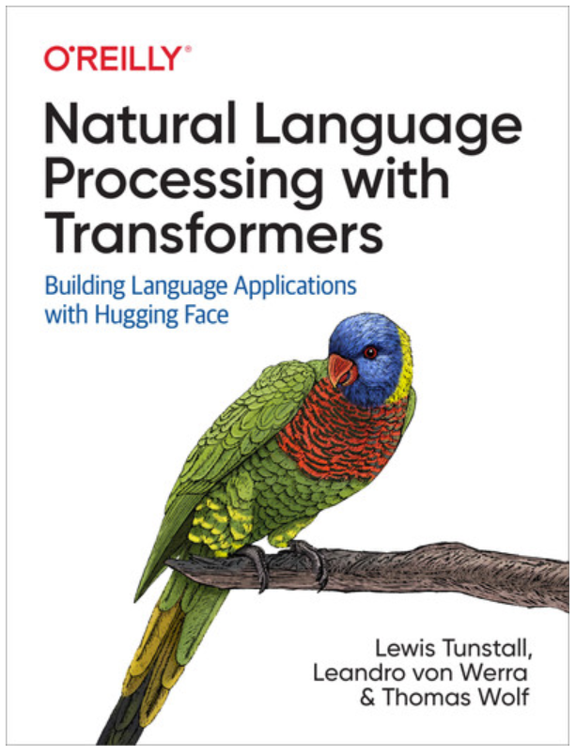
Book: Natural Language Processing with Transformers, Lewis Tunstall, Leandro von Werra, Thomas Wolf (Huggingface cofounder)
First edition (grayscale, March 2022), revised edition (May 2022, color)
https://transformersbook.com/
https://github.com/nlp-with-transformers/notebooks

Slide 6
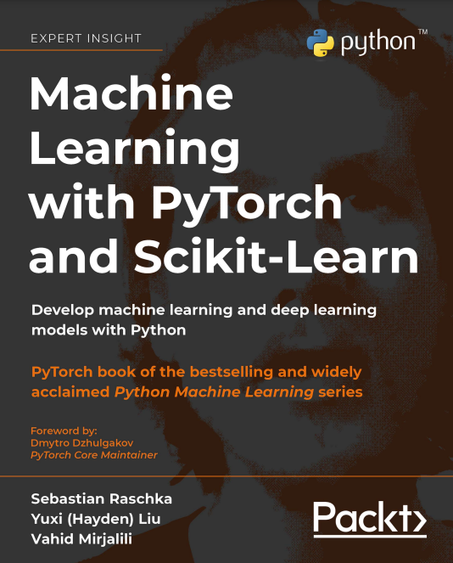
Book: Machine Learning with PyTorch and Scikit-Learn, Sebastian Raschka et al. (February 2022):
Pckt (publisher) - ebook (pdf and epub, drm free), print or combo. Only the ebook is in color, print is grayscale.
Github repo

Slide 7
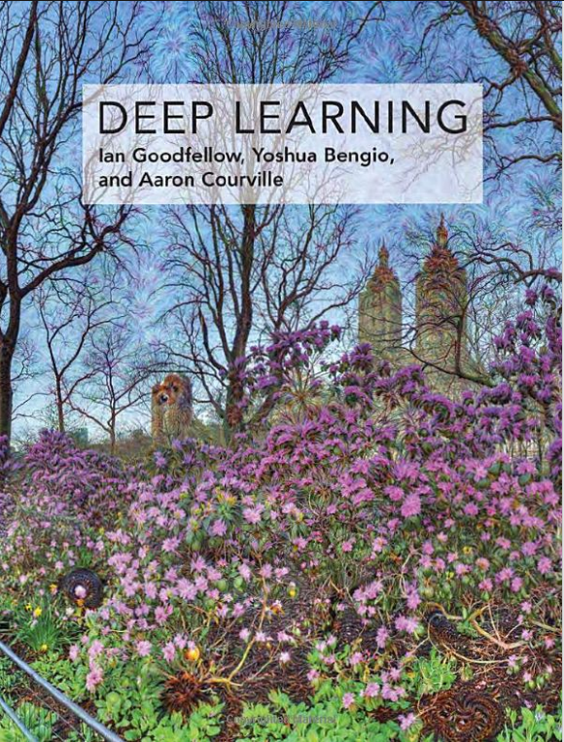
Deep Learning, Goodfellow, Bengio and Courville (November 2016)
HTML version - complete version (legally available)
Lecture Slides - accompanying the book, by Goodfellow

